Slide 1
Articulating Nose Cone
Jed Fazler | Noah Moffeit | Nicholas Samuda | Robert Smith
Notes:
https://visualhunt.com/f7/photo/32891036558/2ed24545c0/

Slide 2
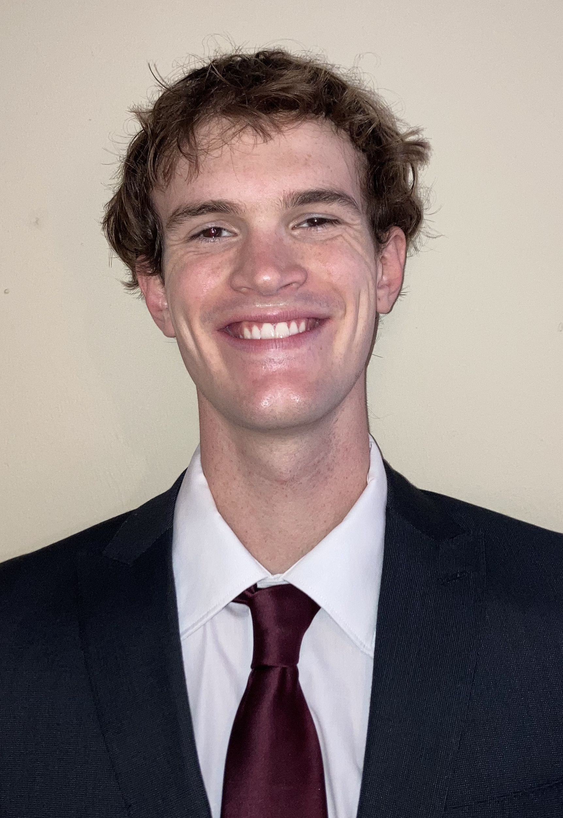
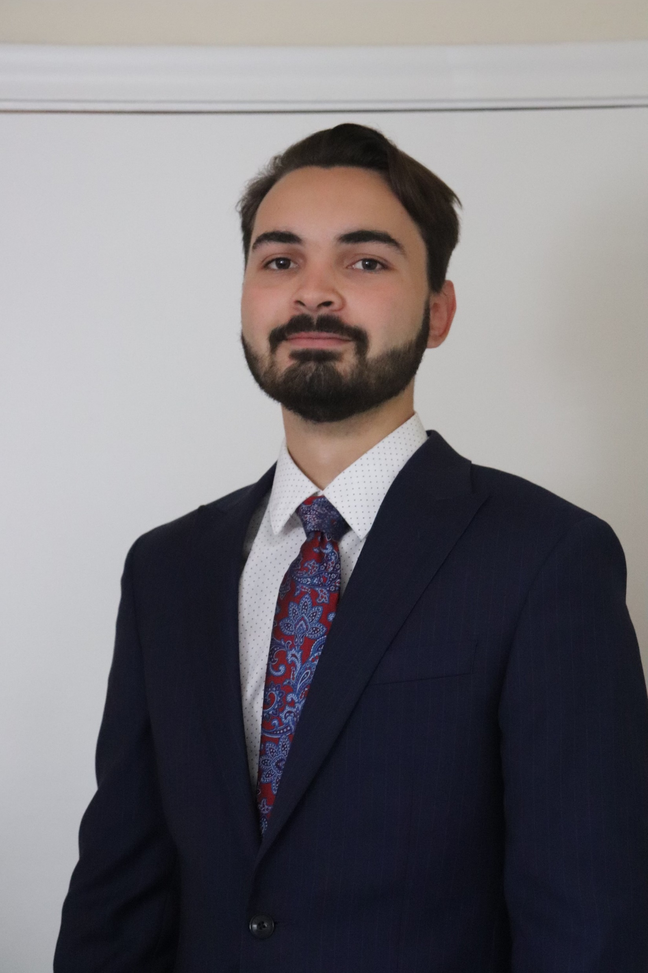
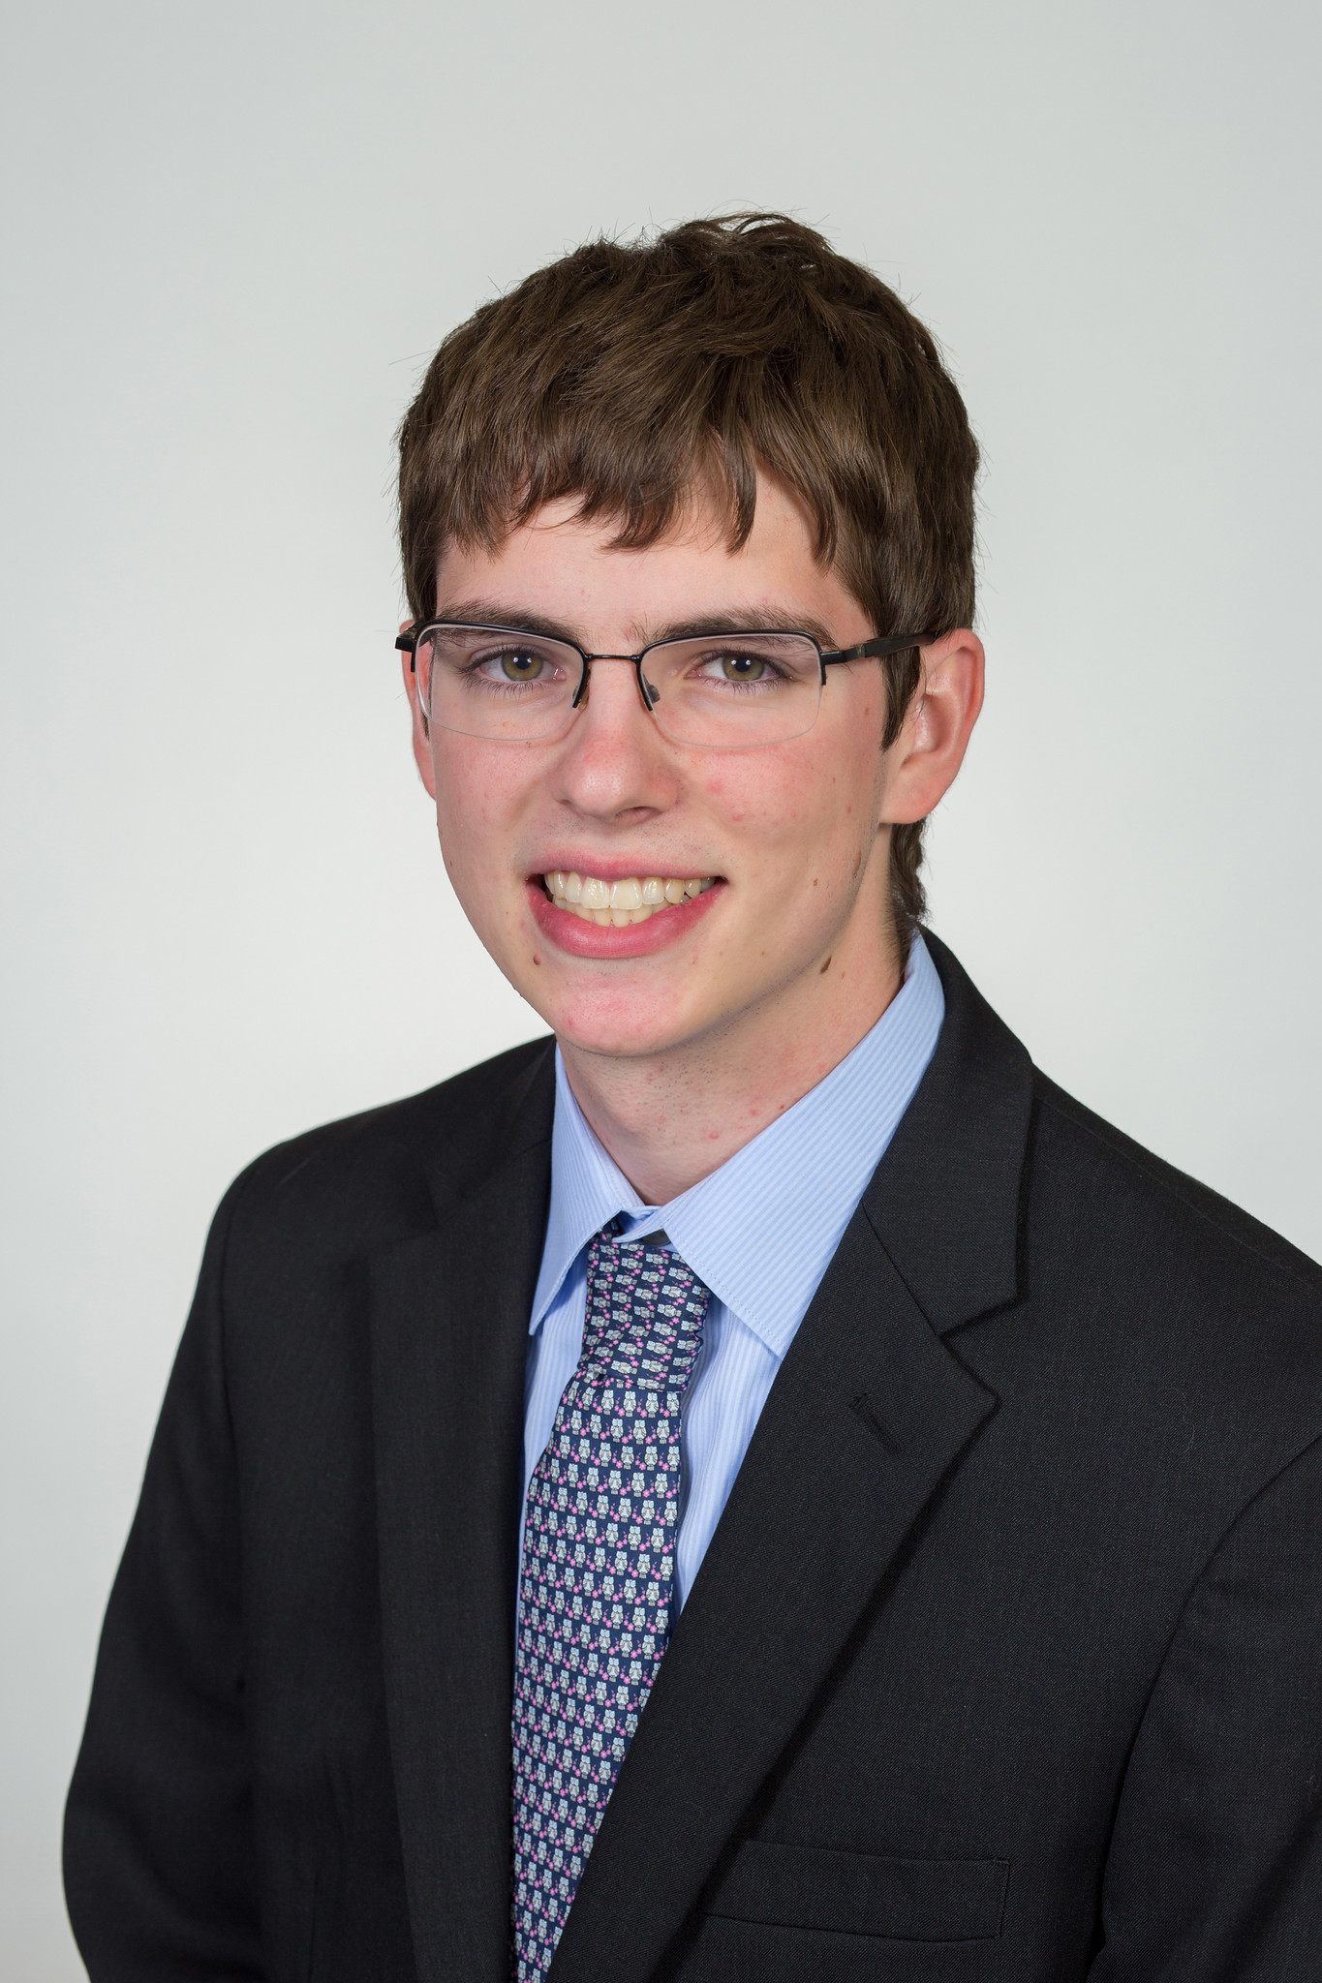
Team 504 Introductions
Jed Fazler
Field Engineer
Noah Moffeit
Test Engineer
Nicholas Samuda
Systems Engineer
Robert Smith
Research Engineer
Nicholas Samuda

Slide 3
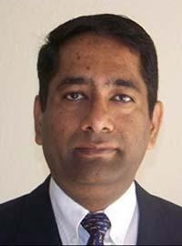
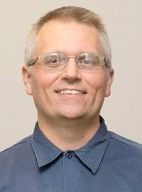
Sponsor and Advisor
Dr. Rajan Kumar
Dr. Jonas Gustavsson
Nicholas Samuda
Notes:
Our project sponsor is Dr. Rajan Kumar, he is an Associate Professor at the FAMU-FSU college of engineering and the Director of the Florida Center for Advanced Aero-Propulsion. Our project advisor is Dr. Jonas Gustavsson who works as an Associate Scientist at FCAAP.

Slide 4
Project Objective
Design and develop a smart projectile technology that can sense and adapt to harsh conditions.
Nicholas Samuda
Notes:
The objective of the Smart Projectile project is to create a technology that will allow for a missile to detect and adapt to harsh conditions.

Slide 5
Customer Needs
Withstand loads from Mach 4 windspeeds
Adapts without user input
Utilizes a control surface other than fin deflection
Can track and follow a single target
Detect conditions in which flow detachment will occur
Nicholas Samuda

Slide 6
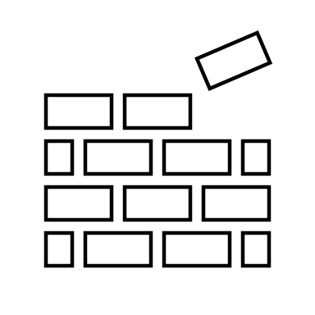
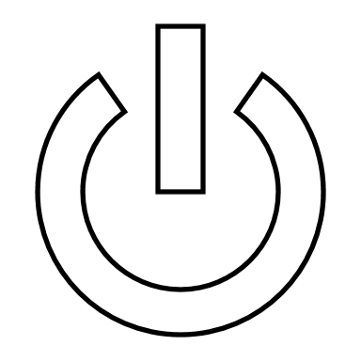
Functional Decomposition
POWER
SENSING
ACTUATION
STRUCTURE
Nicholas Samuda

Slide 7
Critical Targets and Metrics
SENSING
ACTUATION
STRUCTURE
Interprets Sensor Data
Control Pitch,
Roll, and Yaw
Maintains Integrity
Target
300 ms
Pitch Target
CPM $≥$ 3.2
Target
$$σ_{s}=3\left(9.6 psig\right)$$
Roll Target
CRM $≥$ 0.8
Yaw Target
CYM $≥$ 3.2
Nicholas Samuda

Slide 8
Concept Generation
Morphological Chart
Ideas
Brainstorming
Biomimicry
Nicholas Samuda

Slide 9
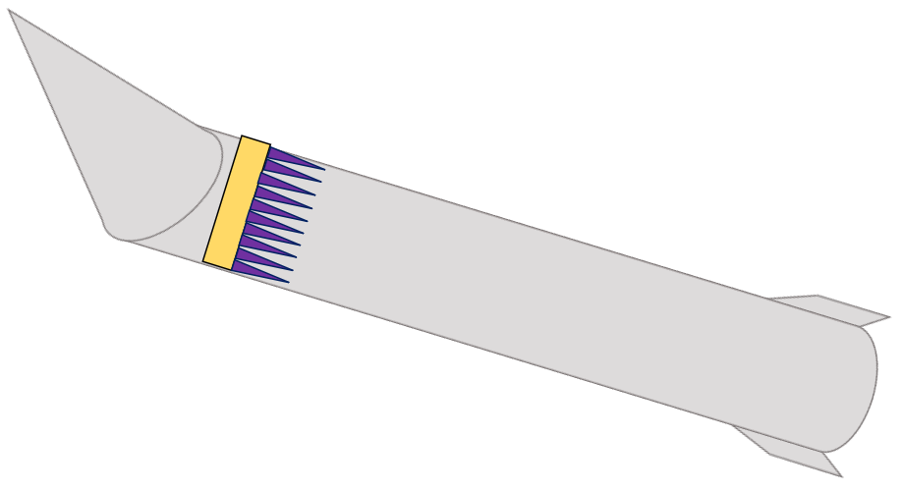
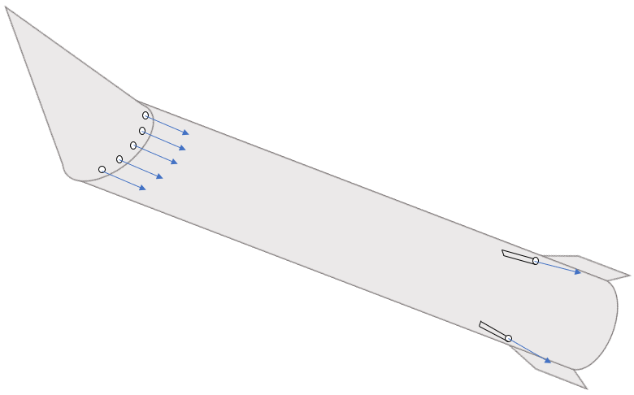
High Fidelity Concepts
Plasma Control with an Articulating Nose Cone
Microjet Control with an Articulating Nose Cone
Sparkjets with a Movable Internal Mass
Nicholas Samuda

Slide 10
Concept Selection
House of Quality – Important Criteria
Controlling flow attachment
Interpreting sensor data
Managing power
AHP had a consistency ratio less than 0.1
Microjet Control with an Articulating Nose Cone
Nicholas Samuda

Slide 11
Our Progress
Targets and metrics
Concept Generation
Concept Selection
Presented to project sponsor
Project scope redefined
Robert Smith

Slide 12
Project Update
Selected Idea
Microjet Control with an Articulating Nose Cone
New Focus
Use only during wind tunnel testing
Control nose deflection during tunnel operation
Mitigate edge effects from nose deflection
Remove active flow control and sensing
Robert Smith

Slide 13
Critical Changes
Reference body dimensions changed
High speed to low speed
Active flow control is no longer involved
Articulation will now be done inside of the wind tunnel
Sensing is no longer a consideration
Robert Smith

Slide 14
Updated Project Scope
Design the method of articulation for a nose cone during testing in a low-speed wind tunnel while keeping a smooth edge transition.
Robert Smith

Slide 15
Updated Functions
CONTROL
POWER
COMMUNICATION
Robert Smith

Slide 16
Updated Functional Decomposition
Nose
Deformation
Delivery
Supply
Signals
Receive
Articulate in α direction
Interpret
Articulate in β direction
Transmit
CONTROL
POWER
COMMUNICATION
Robert Smith

Slide 17
Updated Critical Targets and Metrics
Articulate the nose cone to obtain a pitch and yaw of ± 20°
Keep transition edges smooth between nose and body
θ
Robert Smith

Slide 18
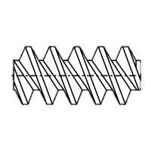
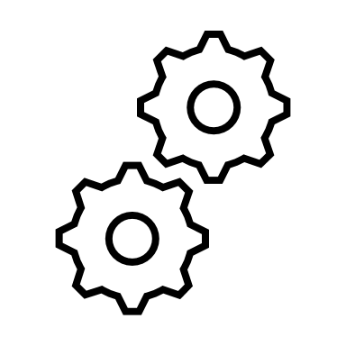
New Concept Generation
Nose Pulleys
Linear Actuators
Rotating Contact Surfaces
2 DOF Gear Box
Polar Controller
Basic Rotating Nose
Robert Smith

Slide 19
Future Work
Present to our project sponsor
Select a design
Prototype mechanism
CAD Work
Robert Smith

Slide 20
Thanks for listening
Questions?
Jed Fazler | Noah Moffeit | Nicholas Samuda | Robert Smith
Notes:
https://visualhunt.com/f7/photo/32891036558/2ed24545c0/

Slide 21
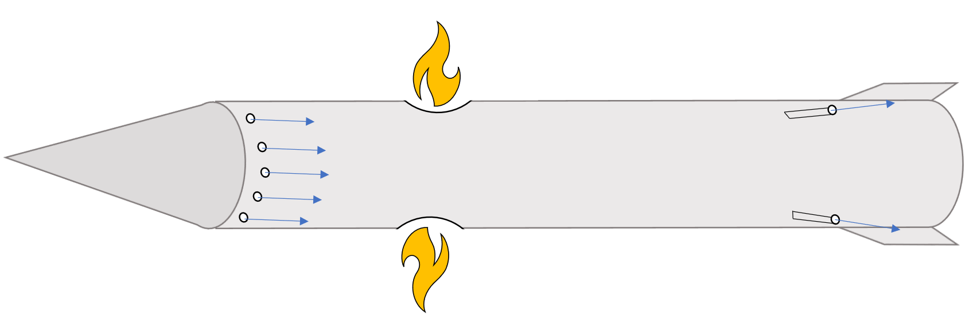
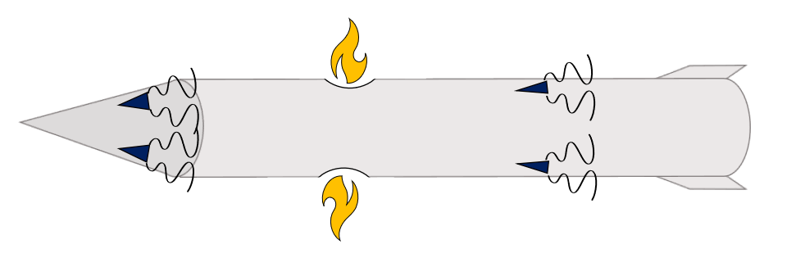
Medium Fidelity
Controllable Internal Mass
Revolving Nose Cone
Gill Intakes
Pulsating Jet with Side Thrusters
Vortex Generators with Side Thrusters

Slide 22
House of Quality
Infuses voice of the customer
Compares customer requirements to engineering characteristics
Results:
Engineering Characteristics: | Controls Flow Attachment | Interprets Sensor Data | Transmits Power to Components | Monitors Sensor Data | Provides Power for Components | Transmits Sensor Data | Controls Aerodynamic Moments | Protects Internal Components
Rank Order: | 1 | 2 | 3 | 4 | 5 | 6 | 6 | 8

Slide 23
Pugh Chart
Allows comparisons of medium and high-fidelity concepts
Original comparison: Basic cylinder with fin deflection
Results:
Concept: | Internal Mass | Articulating Nose Cone and Plasma Actuators | Articulating Nose Cone and Microjets | Internal Mass with Sparkjets
Plus(+): | 2 | 1 | 4 | 3
Satisfactory(S): | 3 | 2 | 2 | 2
Minus(-): | 1 | 3 | 0 | 1

Slide 24
AHP and Design Alternatives
Compared relative importance of engineering characteristics
Determines consistency in importance determination

Slide 25
Final Rating Comparison

Slide 26
Final Selection

Slide 27
Project Description and Key Goals
This project aims to create a technology that can be applied to many projectile configurations, allowing the projectile to maneuver adaptively through unforeseen, hazardous environments. The technology developed will detect said obstacles or conditions and actuate the projectile autonomously.
The key goals were selected to itemize the main objectives that must be accomplished over the duration of the project based on the project’s description and advice from the project’s sponsor. The following are the goals or milestones we have derived to ensure the project’s completion:
Conceptualize and research 5 different innovative ways to maneuver a projectile.
Choose one of these designs to expand upon and develop into a working design.
Develop innovative technologies that can be implemented into the projectile allowing for smart capabilities.
Develop a way for the projectile to adapt to its environment or obstacles through autonomous actions.
Construct a scaled down model of the projectile for use in wind tunnel testing to verify desired aerodynamic characteristics of design.
Construct a prototype projectile to test actuation of the smart functionality within the projectile.

Slide 28
Market
The primary market for this project was seen as the company or organization that the product would be directly constructed for and would use the product.
Primary Markets:
Florida Center for Advanced Aero Propulsion (FCAAP)
The secondary markets are a makeup of other companies or organizations who may benefit from or would be interested in purchasing the results of this project.
Secondary Markets:
Air Force Office of Scientific Research (AFOSR)
Lockheed Martin
Raytheon Technologies
Northrop Grumman

Slide 29
Assumptions
Propulsion
It is assumed that:
Projectile deployment
Entailing storage
Transportation
Initial launch
will be facilitated by technologies already implemented in the projectile. It is also assumed that the projectile will remain within earth’s atmospheric conditions for its use.
Deployment
Storage

Slide 30
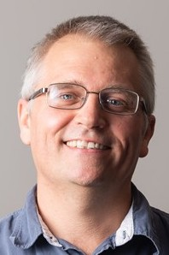
Stakeholders
The stakeholders for this project include all parties who will have influenced the design of the technologies produced by the project as well as those who have invested time and other resources into the project.
Dr. Shayne McConomy
Dr. Rajan Kumar
Dr. Jonas Gustavsson
FCAAP
FAMU-FSU College of Engineering

Slide 31
Customer Needs
How do you think current control surfaces and their actuation can be improved? | Current control surfaces require clean flow, which is not realistic at high angles of attack, so that’s something. | Projectile accommodates for attached flow over control surfaces.
What draw backs come with standard fin deflections as a control surface? | Must have clean flow to actuate properly. Size and weight that come with actuation mechanism | Projectile control surfaces will be suitable effective even in detached flow.
What Mach numbers would be expected for this projectile? | FCAAP polysonic wind tunnel can’t go faster than Mach 5. We’ll probably test Mach 4. | The projectile can withstand Mach 4.
What slenderness ratio of the projectile would be appropriate? | Would be nice if it could be tied into what we have done already. Matching a baseline design here at FCAAP. 8-10 | The projectile uses a basic axisymmetric body configuration based on previously tested models.

Slide 32
Customer Needs
Do we need to worry about designing the method of propulsion? | Don’t worry about designing the propulsion as we cannot have it modeled in the wind tunnel. | Propulsion is beyond the scope of this project.
By the end of this project, what level of manufacturing should be accomplished to demonstrate our results? | Small model for testing control surfaces in wind tunnel, larger model for demonstration purposes and sensing capabilities. Radar sensors possible option. | The projectile is modelled for aerodynamic testing and then prototyped for proof of actuation.
What conditions do you expect the projectile to operate in? | Projectile should go where the target goes. High angles of attack. Initial deployment shockwaves and vortices. Vibrations in supersonic can affect and disrupt the electronics. | The projectile has a way to rapidly adapt to the conditions that exist during deployment.
Should the projectile be able to actuate without user input? | Yes | The projectile is automatically operated.

Slide 33
Customer Needs
Should favorable aerodynamic characteristics be prioritized over functionality? | No, it should accomplish the task while minimizing negative effects. Compare to previous results. | Maintaining aerodynamic characteristics is secondary to maintaining control surface effectiveness.
What is considered a “harsh” or “hazardous” | Vortices, and shockwaves off the parent aircraft. High angles of attack | The missile adapts to high pitch angles.
What will be the preferred method of flow visualization? | It looks good. Better for showing actuation effects. Could be done with shadow graph in the wind tunnel. Not necessary but helpful. | Flow visualization will be done through other tests such as shadowgraph or oil flow.
Will the projectile also have to accommodate targeting? | Does not necessarily need to sense targets, could also sense high angles of attack. | The missile can sense its angle of attack in various scenarios.

Slide 34
Functional Decomposition
Storage
Provides power for components
POWER
Transmission
Transfers power to components
Jed Fazler

Slide 35
Functional Decomposition
Sensors
Monitors sensor data
SENSING
Interprets sensor data
Signaling
Transmits response signal
Jed Fazler

Slide 36
Functional Decomposition
Flow
Maintains flow attachment
Controls pitch
ACTUATION
Mechanical
Controls roll
Controls yaw
Jed Fazler

Slide 37
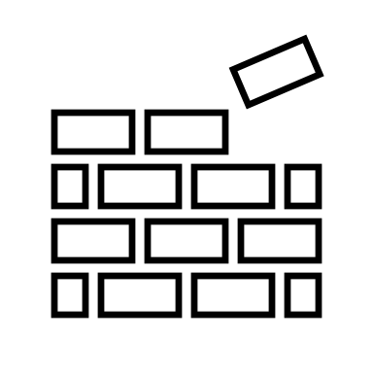
Functional Decomposition
Maintains integrity
STRUCTURE
Protects components
Jed Fazler

Slide 38
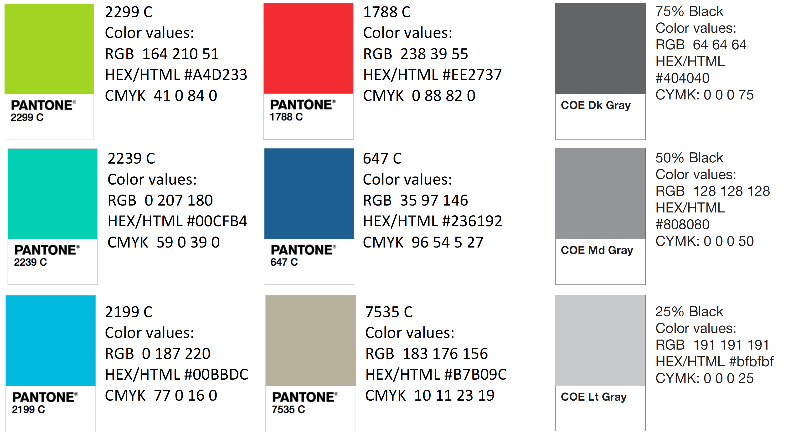
Color Palette
How do you think current control surfaces and their actuation can be improved? | Current control surfaces require clean flow, which is not realistic at high angles of attack, so that’s something. | Projectile accommodates for attached flow over control surfaces.
What draw backs come with standard fin deflections as a control surface? | Must have clean flow to actuate properly. Size and weight that come with actuation mechanism | Projectile control surfaces will be suitable effective even in detached flow.
What Mach numbers would be expected for this projectile? | FCAAP polysonic wind tunnel can’t go faster than Mach 5. We’ll probably test Mach 4. | The projectile can withstand Mach 4.
What slenderness ratio of the projectile would be appropriate? | Would be nice if it could be tied into what we have done already. Matching a baseline design here at FCAAP. 8-10 | The projectile uses a basic axisymmetric body configuration based on previously tested models.

Slide 43
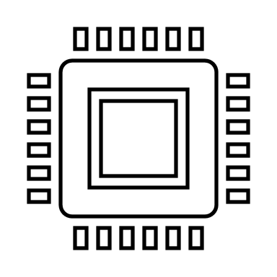
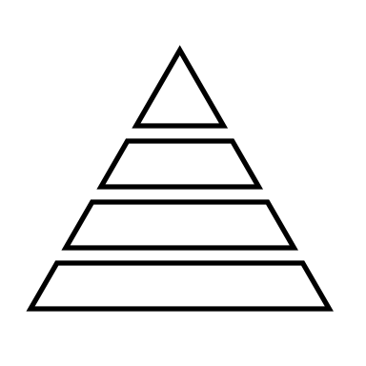
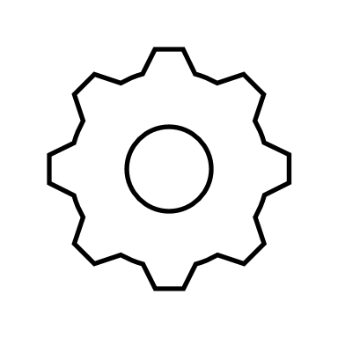

Slide 44
Nose Pulleys
Linear Actuators
Rotating Contact Surfaces
2 DOF Gear Box
Polar Controller
Basic Rotating Nose
Robert Smith

